Slide 1
Finding SNORD116 binding sites

Slide 2
C/D box snoRNA
Imprinted, only fathers allele is expressed
Part of the larger PWS (Prader-Will syndrome) critical region, which is imprinted and expressed from the fathers allele
Loss of SNORD116 cluster leads to a milder, PWS like phenotype
We used fibrobast and crispered out all SNORD116 copies, with the exception of 116-30
Fibroblasts were made into hypothalamic neurons, +/- SNORD116 from isogenic cells compared
RNA was sequenced, 60 million reads per sample, biological triplicates
Changes only in gene expression, hardly any splicing
Enrichment of imprinted genes
A few hormones are deregulated, reminiscent of the phenotype (PENK, SST, GDF3, NODAL)

Slide 3
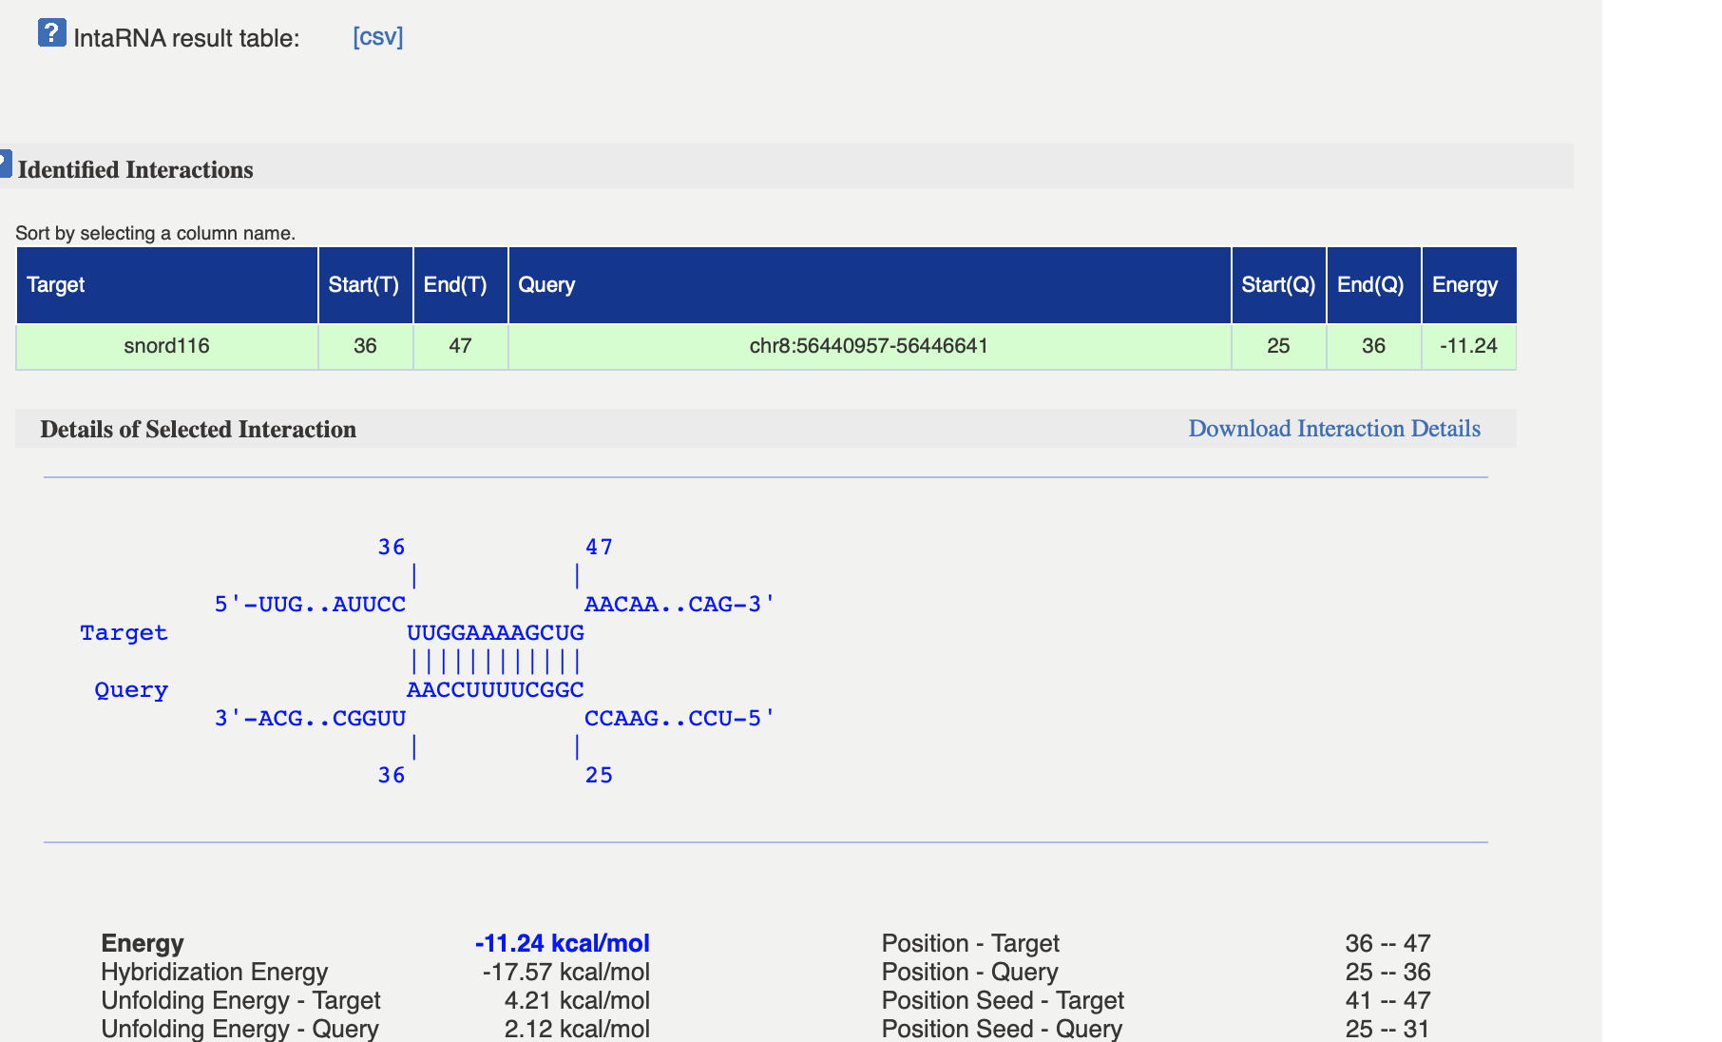
Use intaRNA to map binding sites
Most intaRNA gave only low energy readings (webserver)

Slide 4
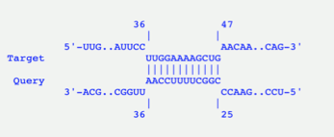
Outline
intaRNA
Interaction sites
+
-
GOI
High energy (top 30%?) of SNORD116 binding sites
On the plus and minus strand
Do SNORD116
high energy binding
sites cluster on a single gene?
Could be from different SNORD116 copies
Since there is an over representation of changed imprinted genes, look at plus (coding) and minus (non-coding strand), there might be unknown antisense RNAs
Include 1000 nt upstream and downstream to account for promoter and UTR/stability effects

Slide 5
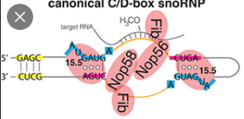
Where are the binding sites on 116 copies?
116-1 chr15(+):25051477-25051571
ttGGATCGATGATGAGTCCCCTATAAAAACATTCCTTGGAAAAGCTGAACAAAATGAGTGAGAACTCATAACGTCATTCTCATCGGAACTGAGGTCCag
TGATGA: C box, CTGA: D box
“normal” C/D box snoRNAs bind their targets between the C and D boxes
HOWEVER, SNORD116 is biochemically different, and the D’ box is not in consensus
Map the binding sites on the SNORD116 copies: do they cluster around regions?
Binding sites of targets
Binding sites of targets
C
D’
C’
D

Slide 6
Human (30)
116-1 chr15(+):25051477-25051571
ttGGATCGATGATGAGTCCCCTATAAAAACATTCCTTGGAAAAGCTGAACAAAATGAGTGAGAACTCATAACGTCATTCTCATCGGAACTGAGGTCCag
116-2 chr15(+):25054208-25054306
ttGGATCGATGATGAGTCCCCAAAAAAAACATTCCTTGGAAAAGCTGAACAAAATGAGTGAAAACTCATACCGTCATTCTCATCGGAACTGAGGTCCag
116-3 chr15(+):25056860-25056954
ttGGATCGATGATGAGTCCCCCATAAAAACATTCCTTGGAAAAGCTGAACAAAATGAGTGAGAACTCATACCGTCGTTCTCATCGGAACTGAGGTCCag
116-4 chr15(+):25059538-25059633
ttGGATCGATGATGAGTCCCCCCAAAAAAACATTCCTTGGAAAAGCTGAACAAAATGAGTGAAAACTCATACCGTCGTTCTCAGCGGAACTGAGGTCCag
116-5 chr15(+):25062333-25062427
ttGGATCGATGATGAGTCCCCCATAAAAACATTCCTTGGAAAAGCTGAACAAAATGAGTGAGAACTCATACCGTCGTTCTCATCAGAACTGAGGTCCag
116-6 chr15(+):25065026-25065121
ttGGATCGATGATGAGTCCTCCAAAAAAAACATTCCTTGGAAAAGCTGAACAAAATGAGTGAAAACTCATACCGTCATTCTCATCGGAACTGAGGTCCag
116-7 chr15(+):25067788-25067882
ttGGATCGATGATGAGTCCCCCATAAAAACATTCCTTGGAAAAGCTGAACAAAATGAGTGAGAACTCATACCGTCGTTCTCATCAGAACTGAGGTCCag
116-8 chr15(+):25070432-25070526
ttGGATCGATGATGAGTCCTCCAAAAAAACATTCCTTGGAAAAGCTGAACAAAATGAGTGAGAACTCATACCGTCGTTCTCATCGGAACTGAGGTCCag
116-9 chr15(+):25073107-25073201
ttGGATCGATGATGAGTCCCCCATAAAAACATTCCTTGGAAAAGCTGAACAAAATGAGTGAGAACTCATACCGTCGTTCTCATCGGAACTGAGGTCCag
116-10 chr15(+):25074114-25074215
gtAGGTTGATGATGACTTACATATATACGTTTTTTTTTTTTTTTTGGAAAGGTGAACAAAATGAGTGAAAACTCAGTACCATCATCCTCATCTAACTGAGGTCCag
116-11 chr15(+):25075929-25076020
atGGATCAATGATGACTTCCATACGTGGGTTCCTTGGAAAGTTGAACAAAATGAGTGAAAACTTTATACTGTCATCCTCTTCAAACTGAGGTCCag
116-12 chr15(+):25077051-25077142
ctGGATCAATGATGACTTCCATATATACATTCCTTGGAAAGCTGAATAAAATGAATGAAAACTCTATACCATCATCCTCATTGAACTGAGGTCCca
116-13 chr15(+):25079058-25079149
atGGACCAATGATGACTTCCATACATGCATTCCTTGGAAAGCTGAACAAAATGAGTGGGAACTCTGTACTATCATCTTAGTTGAACTGAGGTCCac
116-14 chr15(+):25080142-25080233
gtGGATCGATGATGACTTCCATATATACATTCCTTGGAAAGCTGAACAAAATGAGTGAAAACTCTATACCGTCATTCTCGTCGAACTGAGGTCCag
116-15 chr15(+):25081287-25081378
gtGGATCGATGATGACTTCCATATATACATTCCTTGGAAAGCTGAACAAAATGAGTGAAAACTCTATACCGTCATCCTCGTCAAACTGAGGTCCag
116-16 chr15(+):25082768-25082859
atGGATCGATGATGACTTTCATACATGCATTCCTTGGAAAGCTGAACAAAATGAGTGAAAACTCTATACCGTCATCCTCGTCGAACTGAGGTCCag
116-17 chr15(+):25083588-25083679
atGGATCGATGATGACTTCCATATATACATTCCTTGGAAAGCTGAACAAAATGAGTGAAAACTCTATACCGTCATCCTCGTCGAACTGAGGTCCag
116-18 chr15(+):25085385-25085476
ctGGATCGATGATGACTTCCTTATATACATTCCTTGGAAAGCTGAACAAAATGAGTGAAAACTCTATACCGTCATCCTCGTCGAACTGAGGTCCag
116-19 chr15(+):25086527-25086618
gtGGATCGATGATGACTTCCATATATACATTCCTTGGAAAGCTGAACAAAATGAGTGAAAACTCTATACCGTCATCCTCGTCGAACTGAGGTCCag
116-20 chr15(+):25087662-25087753
gtGGATCGATGATGACTTCCATATATACATTCCTTGGAAAGCTGAACAAAATGAGTGAAAACTCTATACTGTCATCCTCGTCGAACTGAGGTCCag
116-21 chr15(+):25088804-25088895
gtGGATCGATGATGACTTCCACATATACATTCCTTGGAAAGCTGAACAAAATGAGTGAAAACTCTATACCGTCATCCTCGTCGAACTGAGGTCCag
116-22 chr15(+):25089923-25090014
ctGGATCGATGATGACTTCCATATGTACATTCCTTGGAAAGCTGAACAAAATGAGTGAAAACTCTATACCGTCATCCTCGTCGAACTGAGGTCCag
116-23 chr15(+):25091786-25091877
atGGATCGATGATGACCTCAATACATGCATTCCTTGGAAAGCTGAACAAAATGAGTGAAAACTCTATACCGTCGTCCTCGTCAAACTGAGGTCCag
116-24 chr15(+):25094037-25094128
atGGATCGATGATGACTTTTATACATGCATTCCTTGGAAAGCTGAACAAAATGAGTGAAAACTCTATACCGTCATCTTCGTTGAACTGAGGTCCag
116-25 chr15(+):25097663-25097754
ctGGATCGATGATGACTTTAAAATGGATCTCATCGGAATCTGAACAAAATGAGTGACCAAATCACTTCTGTGCCACTTCTGTGAGCTGAGGTCCag
116-26 chr15(+):25099499-25099594
ctGGATCGATGATGACTATAAAAAAAATGGATCTCATCGGAATCTGAACAAAATGAGTGACCAAATCATTTCTGTGCCACTTCTGTGAGCTGAGGTCCag
116-27 chr15(+):25101575-25101666
ctGGATCGATGATGACTTAAAGATTTATCTAATTTAAATCTGAACAAAATGAGTGACCAAAACACTTCTGTACCACTTCTGTGAGCTGAGGTCCag
116-28 chr15(+):25104642-25104732
ctGGATGGATGACGACTTAAAAATGAATCTCGTTGGAATCTGAGCAAAACGAGTGAGCAAACCACTTCTGTGCAGTTCTGTGAACTGAGGTCAag
116-29 chr15(+):25106521-25106603
ctGGATCGATGATGACTTAAAAAAATGGAAACCTTGGAAATCTGAACAAAATGAGTGACCAAGACACTTCTGTGAGCTGAGGTCCag
116-30 chr15(+):25108268-25108352
ctGGATTGACGATGACTTTAAAAAAAAAAAATCTCATTGAAATCTGAAAAAAATGAGTGACCAAACCACTTCTGTGAGCTGAGGTCCag
See also word doc

